Slide 1

Title: Emoji Catcher Game
Internship Member
K. Rupavathi (322103210066)
Internship Mentor
K. ROHINI
Associate Professor
CSE Department
Department of Computer Science and Engineering
GAYATRI VIDYA PARISHAD COLLEGE OF ENGINEERING FOR WOMEN(A)
[Approved by AICTE NEW DELHI, Affiliated to AU Visakhapatnam]
[Accredited by National Board of Accreditation(NBA) for B.Tech. CSE, ECE & IT – valid from 2019-22 and 2022-25]
[Accredited by National Assessment and Accreditation Council (NAAC) with A Grade – valid from 2022-27]
Kommadi, Madhurawada, Visakhapatnam – 530048
Academic Batch : 2024-25

Slide 2
Contents
Abstract
Problem Definition
Existing System
Proposed System
Internship Project Workflow (Architectural Diagram)
Implementation
Results( Screenshots)
Conclusion
References

Slide 3

Certificate

Slide 4
ABSTRACT
This HTML, CSS, and JavaScript code implements a simple "Emoji Catcher
Game” playable in a web browser. The game presents a grid of squares, and single
emoji is randomly placed within one of them. The player's objective is to click on
the square containing the emoji within a 60-second time limit. A correct guess
reveals the emoji, increments the player's score, and promptly hides the emoji
again, relocating it to a new random square. The code manages the game's user
interface, including displaying the score, remaining time, and the grid of squares

Slide 5
PROBLEM STATEMENT
Develop a simple, engaging web-based game where players must quickly locate and
"catch" a randomly appearing emoji within a grid of squares. The game should
present a clear visual interface with a score tracker and countdown timer, providing
immediate feedback for correct and incorrect guesses. The game should end after a
set time limit, displaying the player's final score. The game should also reset after
the timer runs out.

Slide 6
LIMITATIONS IN EXISTING SYSTEM
No High Score/Persistence: The game doesn't store or display high scores. There's no way to track player progress over multiple sessions.
Limited Difficulty/Progression: The game's difficulty remains constant. There's no increase in speed, number of emojis, or other mechanics to challenge the player as they progress.
Lack of Responsiveness: While the grid has a max-width, it might not adapt perfectly to all screen sizes, especially mobile devices. More robust responsive design techniques (like media queries) would improve the experience on different devices.
No High Score/Persistence: The game doesn't store or display high scores. There's no way to track player progress over multiple sessions.

Slide 7



PROPOSED METHODOLOGY/ ARCHITECTURE
[Work Flow Diagram ]
Start Game
End Game (Display final score)
Randomize Emoji(Choose a random square to hide)
=0
Countdown
Timer (Decrement time)
> 0
Wait for User
Input (Click)
Reveal Square (Check if square has emoji)
Reset Square (Hide emoji)
Yes: Reveal Emoji No: Show Wrong Attempt
Update Score (Increment score)

Slide 8
PROPOSED METHODOLOGY CONTD..
The "Emoji Catcher" game is a simple and engaging interactive experience where players click on
grid squares to find a hidden emoji. The interface consists of a score display, a timer, and a grid of
clickable squares, all styled for visual appeal and responsive interaction. The game randomly places an
emoji in one of the squares each round. Players earn points by correctly identifying the emoji, with
the grid resetting for the next round. Incorrect clicks show a brief "❌" indicator. A countdown timer limits
the game duration, and the player’s final score is displayed once the timer reaches zero.
The game initializes with the startGame function, which sets up event listeners, starts the timer, and randomizes the emoji position. It begins automatically on page load. While the game is straightforward, potential enhancements include adding difficulty levels, dynamic time adjustments, a leaderboard, multiple emojis, and sound effects to create a more challenging and immersive experience.

Slide 9

IMPLEMENTATION [ CODING Files ]
The implementation begins with a simple HTML structure, including a div for the score, another for the timer, and a grid container for 10 squares. Each square is dynamically generated using a loop that creates div elements styled with basic dimensions and a border. The JavaScript manages game logic: a clickSquare function checks if the clicked square contains the emoji, increments the score if correct, and updates the score display. The randomize function clears previous emoji placements, selects a random square, and displays the emoji in it. A setInterval function manages the countdown timer, decreasing the time each second and updating the display. When the time reaches zero, it triggers an alert displaying the final score and ends the game. This concise structure keeps the code functional while minimizing complexity.

Slide 10
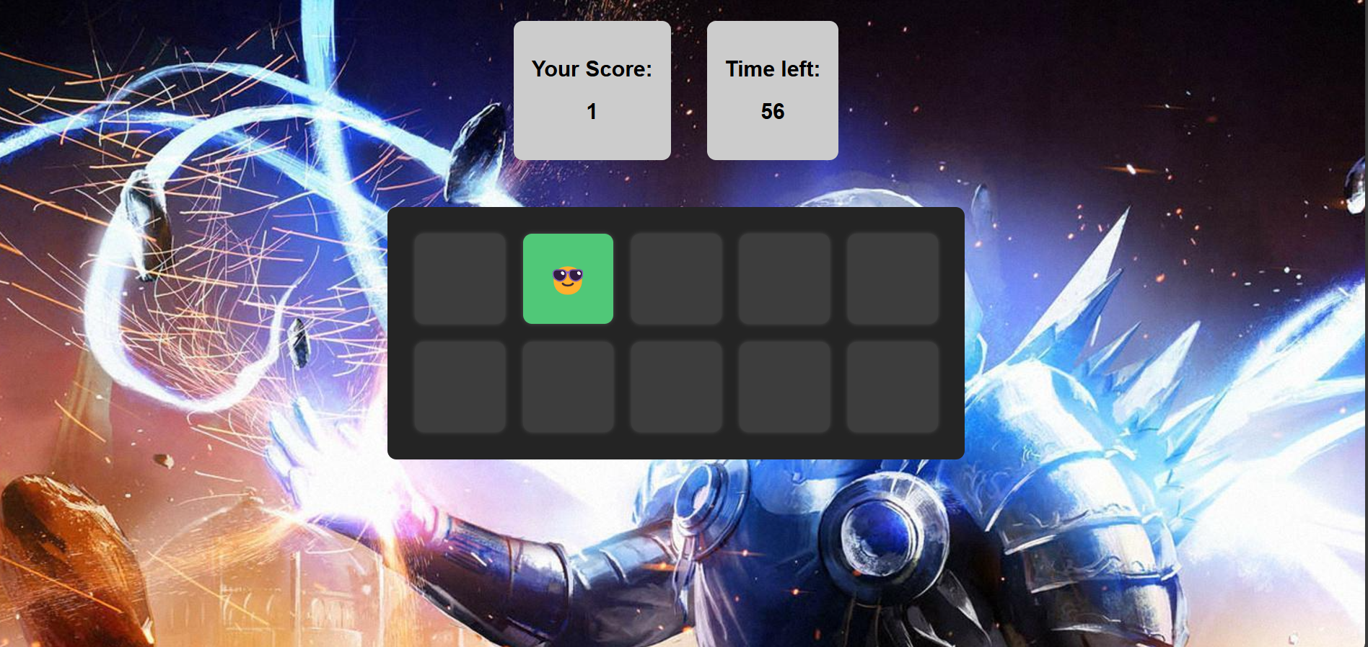
OUTPUT SCREENSHOTS

Slide 11
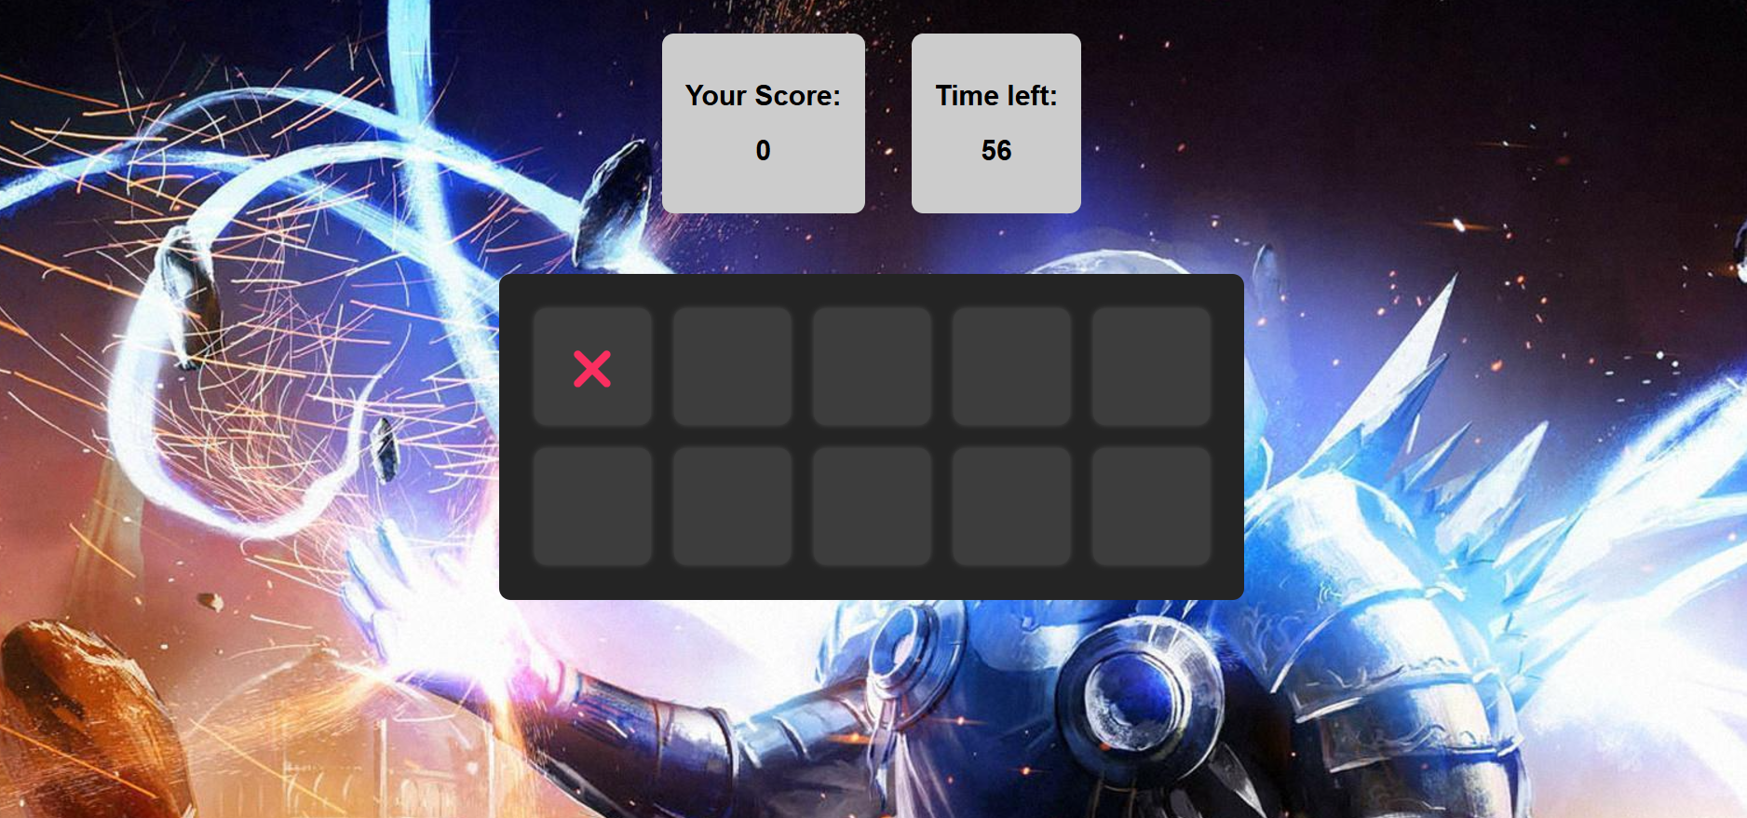
OUTPUT SCREENSHOTS

Slide 12
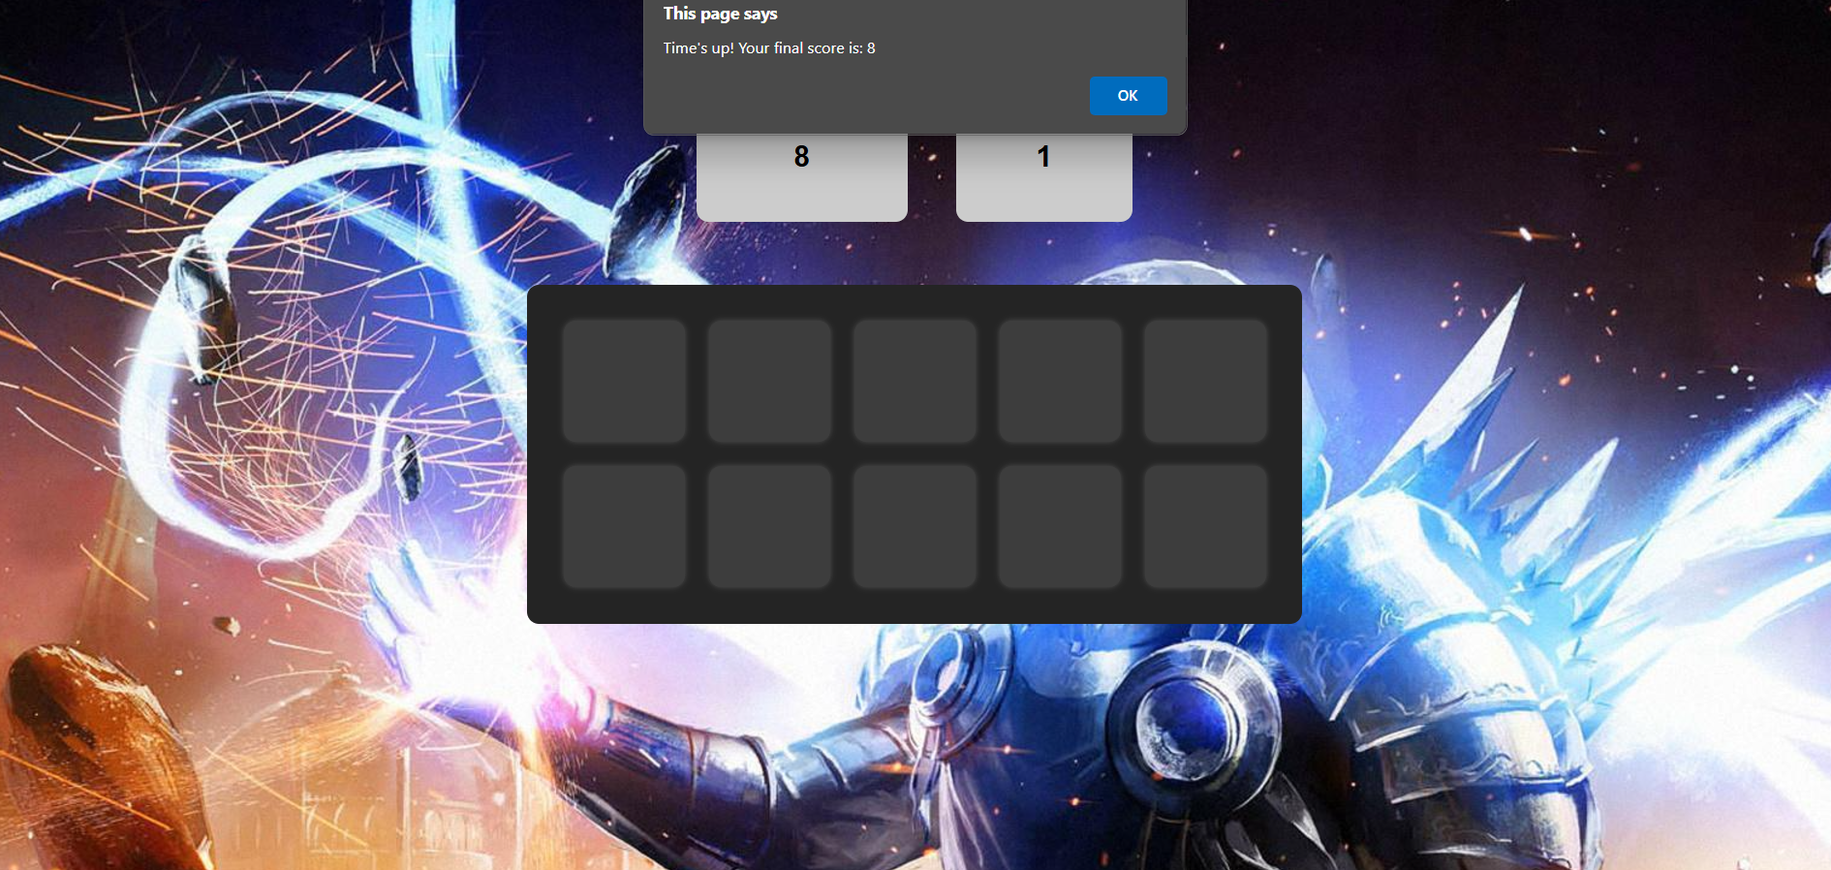
OUTPUT SCREENSHOTS

Slide 13
CONCLUSION
In conclusion, the provided code implements a simple and interactive "Emoji Catcher"
game using HTML, CSS, and JavaScript. It generates a grid of clickable squares
where a random square displays an emoji, and the player must click on the correct
square to earn points. The game includes a countdown timer that ends the game when
time runs out, displaying the final score. By combining basic DOM manipulation,
event handling, and timers, the game offers a fun and engaging user experience with
minimal code. This implementation demonstrates how to create a simple yet
functional game while keeping the code concise and efficient.

Slide 14
REFERENCES
LINKS
1. Emoji Game Catcher:https://codewithcurious.com/projects/emoji-catcher-game-using- html-css-and-javascript/
2.JavaScript:https://www.youtube.com/watch?v=NHNqHSoU50c&list=PLkusOHO_VvuC5im0DL62_FXPHdfE3GWjd
BOOKS:
HTML AND CSS:Design and build websites-by Jon Duckett

Slide 15
Thank You Sir/Mam

